Slide 1
Chapter 11
Data Link Protocols
Asynchronous Protocols
Synchronous Protocols
Character-Oriented Protocols
Bit-Oriented Protocols
WCB/McGraw-Hill
© The McGraw-Hill Companies, Inc., 1998

Slide 2
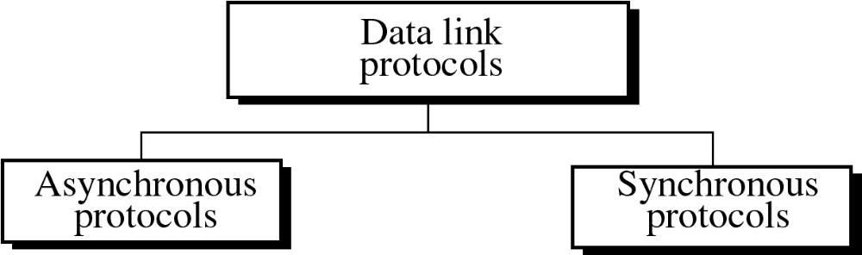
Figure 11-1
WCB/McGraw-Hill
© The McGraw-Hill Companies, Inc., 1998

Slide 3
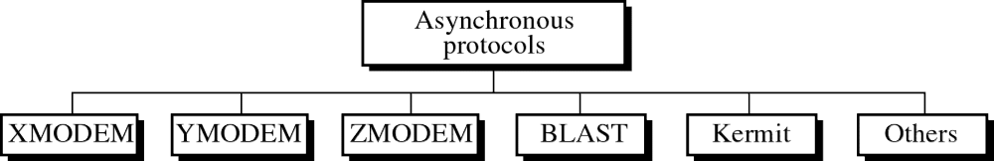
Figure 11-2
WCB/McGraw-Hill
© The McGraw-Hill Companies, Inc., 1998

Slide 4
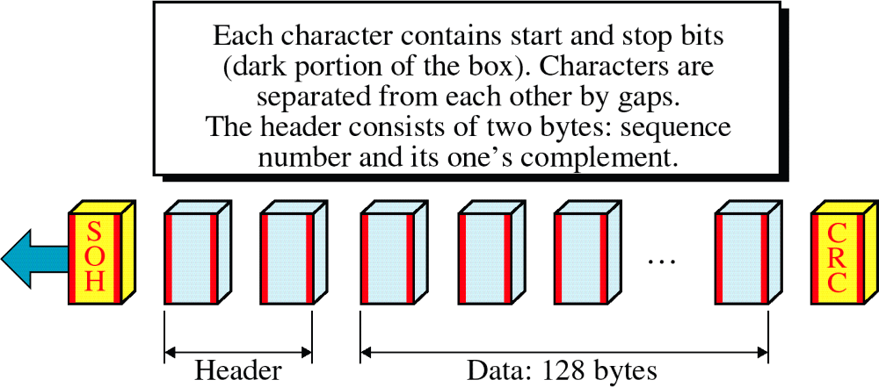
Figure 11-3
XMODEM
WCB/McGraw-Hill
© The McGraw-Hill Companies, Inc., 1998

Slide 5
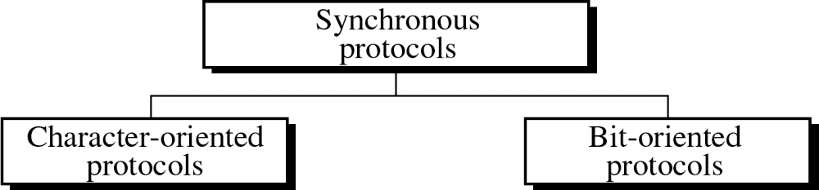
Figure 11-4
WCB/McGraw-Hill
© The McGraw-Hill Companies, Inc., 1998

Slide 6
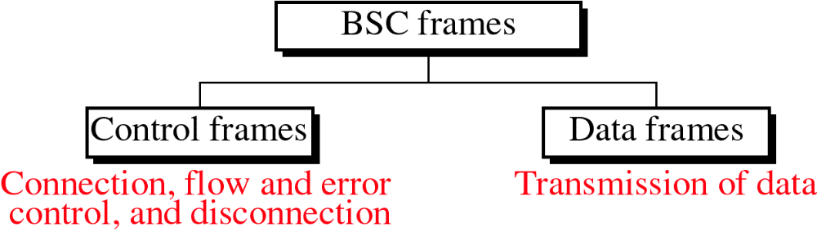
Figure 11-5
WCB/McGraw-Hill
© The McGraw-Hill Companies, Inc., 1998

Slide 7
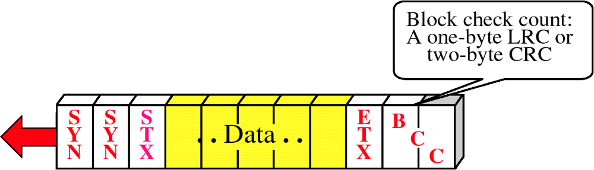
Figure 11-6
Simple Frame
WCB/McGraw-Hill
© The McGraw-Hill Companies, Inc., 1998

Slide 8
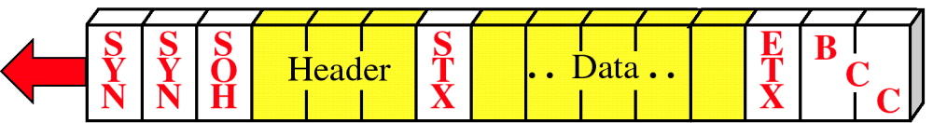
Figure 11-7
A Frame with Header
WCB/McGraw-Hill
© The McGraw-Hill Companies, Inc., 1998

Slide 9
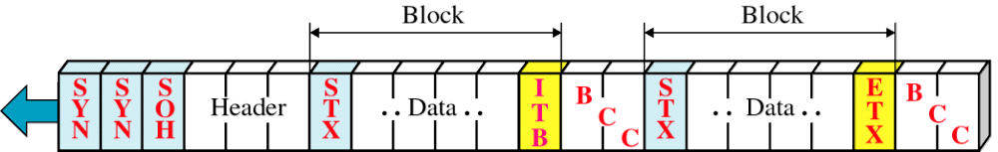
Figure 11-8
Multiblock Frame
WCB/McGraw-Hill
© The McGraw-Hill Companies, Inc., 1998

Slide 10
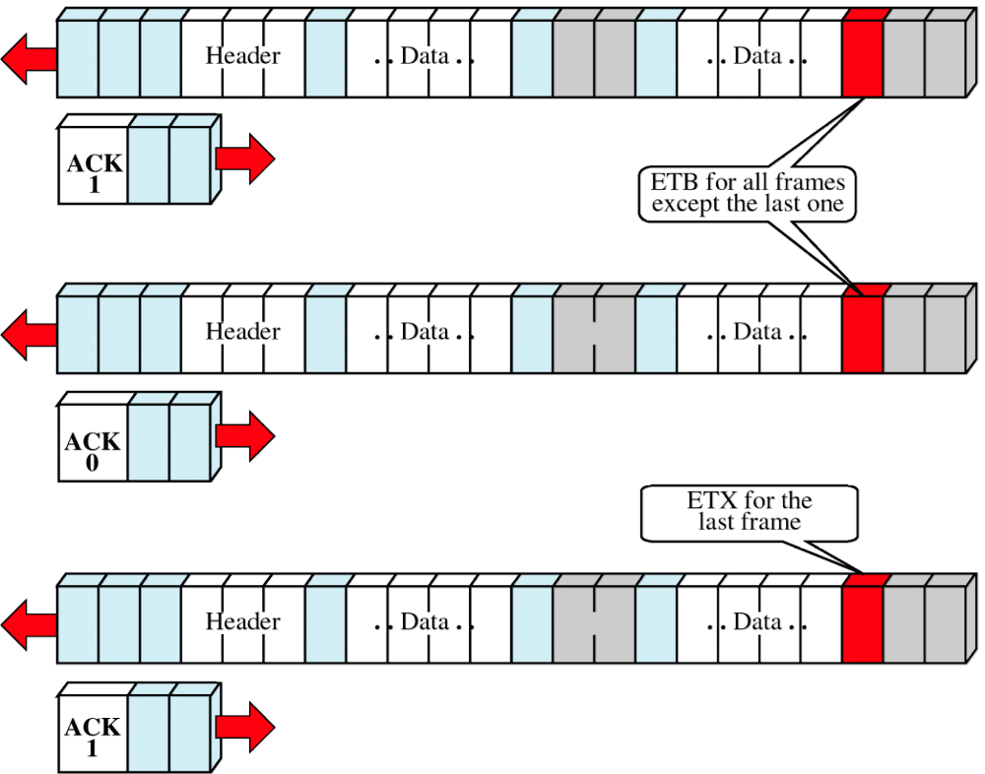
Figure 11-9
Multiframe Transmission
WCB/McGraw-Hill
© The McGraw-Hill Companies, Inc., 1998

Slide 11
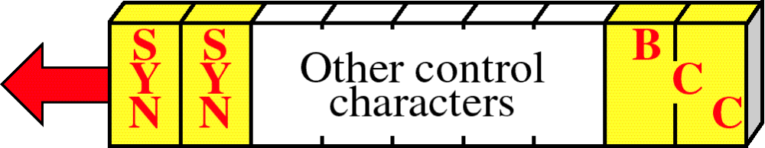
Figure 11-10
Control Frame
WCB/McGraw-Hill
© The McGraw-Hill Companies, Inc., 1998

Slide 12
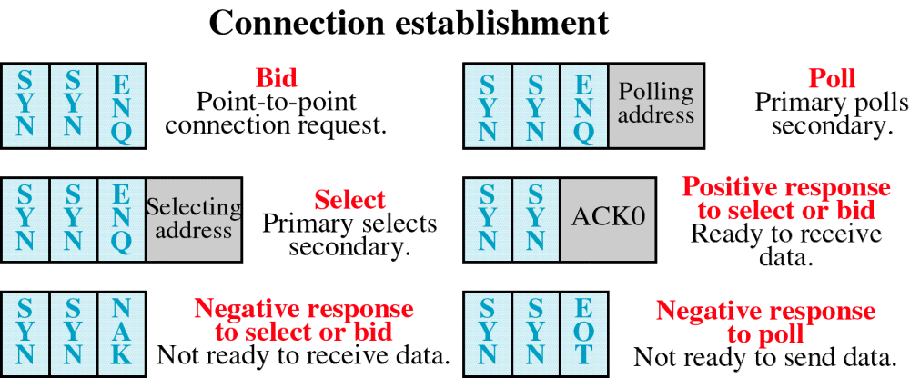
Figure 11-11
Control Frames
WCB/McGraw-Hill
© The McGraw-Hill Companies, Inc., 1998

Slide 13
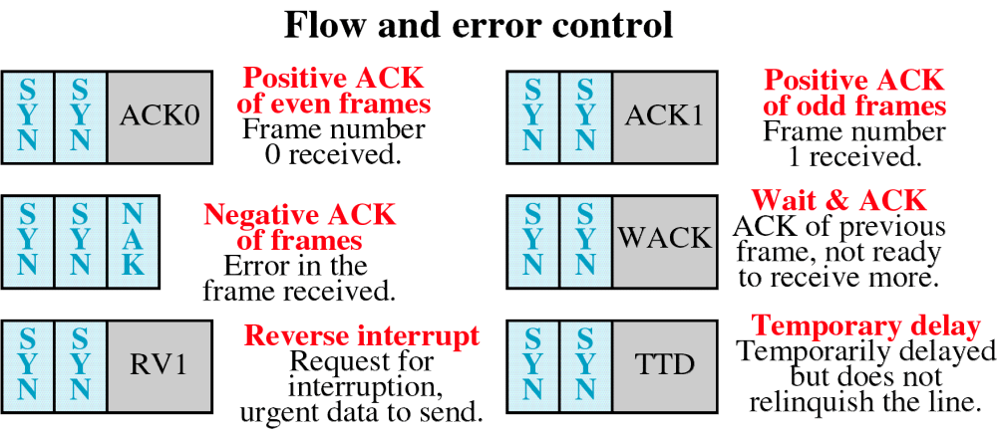
Figure 11-11-continued
Control Frames
WCB/McGraw-Hill
© The McGraw-Hill Companies, Inc., 1998

Slide 14
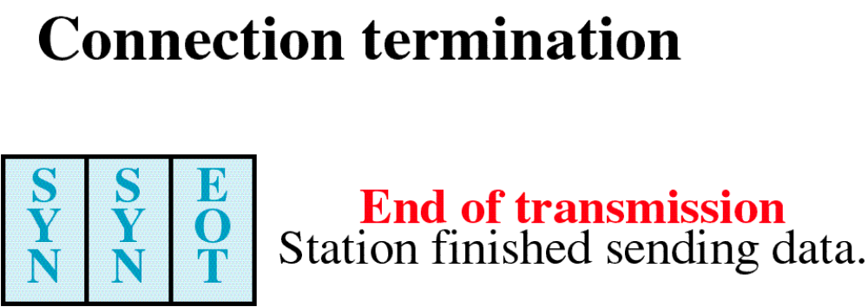
Figure 11-11-continued
Control Frames
WCB/McGraw-Hill
© The McGraw-Hill Companies, Inc., 1998

Slide 15
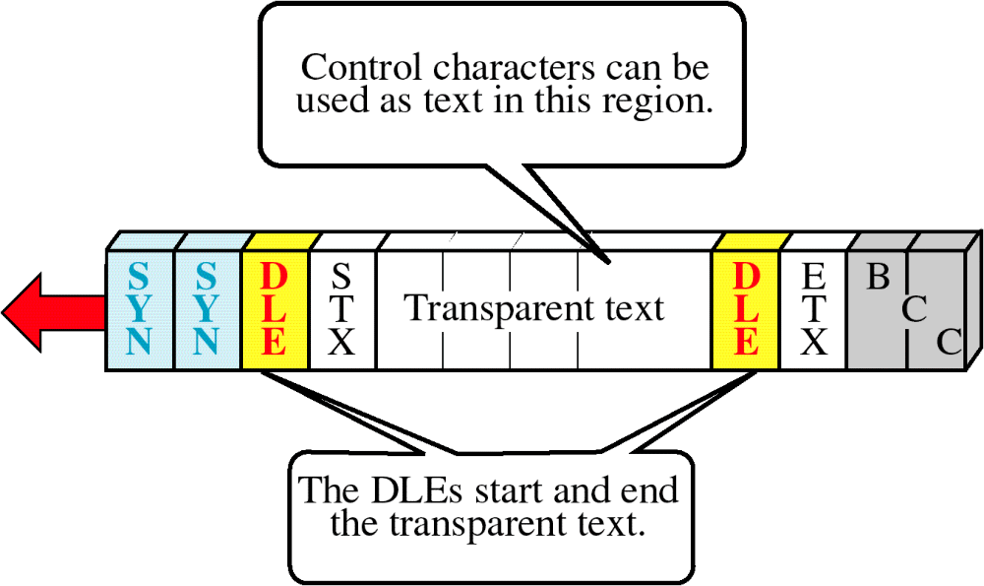
Figure 11-12
Byte Stuffing
WCB/McGraw-Hill
© The McGraw-Hill Companies, Inc., 1998

